Slide 1


Slide 2
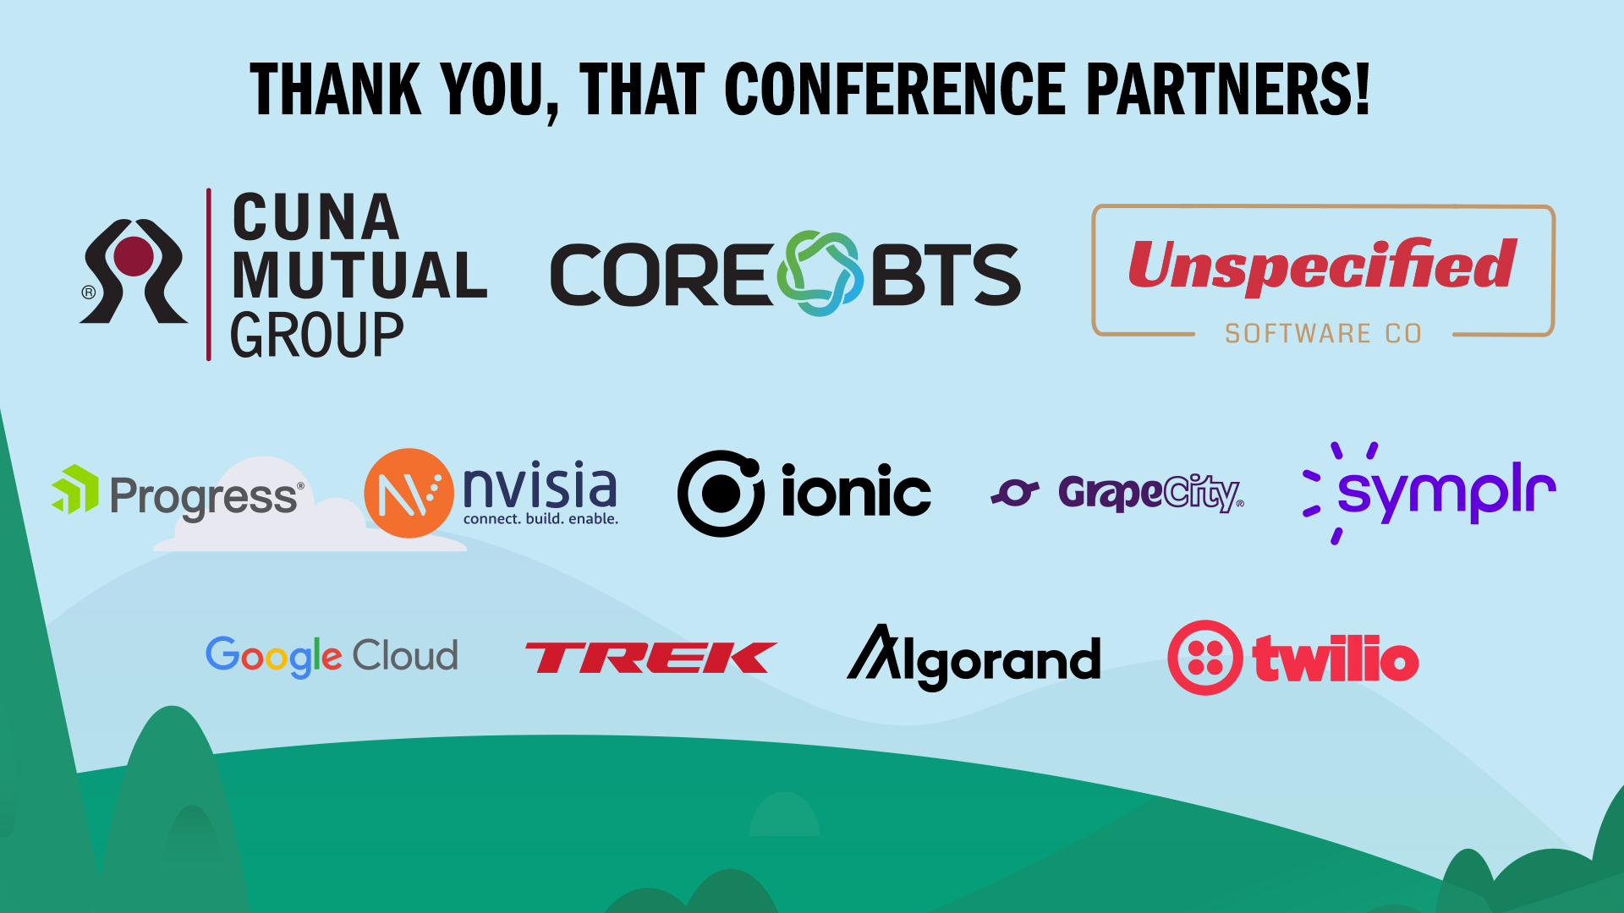

Slide 3


Slide 4


Slide 5


Slide 6
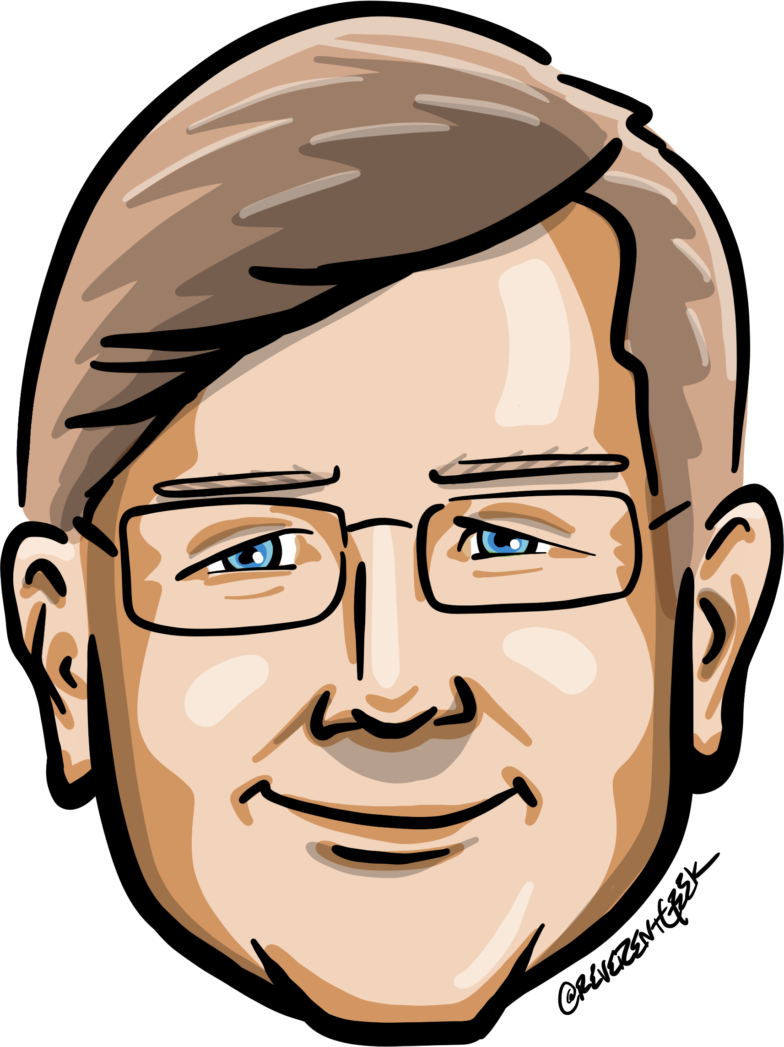





Who is Chad Green
chadgreen@chadgreen.com
TaleLearnCode
ChadGreen.com
ChadGreen & TaleLearnCode
ChadwickEGreen

Slide 7




August 17 – 19, 2022
Keynote – Christina Aldan
.NET Rocks! 20th Anniversary Party
A Toast to Women in Technology

Slide 8
Preamble
Building Event-Driven Microservices

Slide 9
Monolith
Enterprise Architecture
UI
Database
Order Processing
Payment Processing
Inventory Management
Notification
Fulfillment

Slide 10
Microservices
Enterprise Architecture
UI
API Gateway
Order Processing
Payment Processing
Inventory Management
Notifications
Fulfillment

Slide 11
Process Flow
Microservices
UI
API Gateway
Order Processing
Payment Processing
Inventory Management
Notification
Fulfillment
Place Order
Place Order
Charge Credit Card
Return Conf #
Update Inventory
Return Confirmation
Send Order Confirmation
Return Confirmation
Create
Shipping Label
Return Confirmation
Return Confirmation
Return Confirmation

Slide 12
Event-Driven Architecture
Building Event-Driven Microservices

Slide 13
Event-Driven Architecture
A software architecture pattern promoting the production, detection, consumption of, and reaction to events.
- Wikipedia -

Slide 14
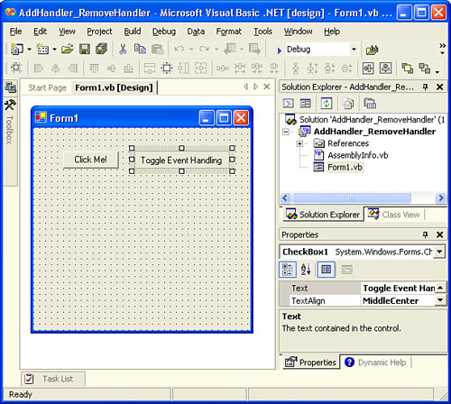
Event-Driven Architecture

Slide 15
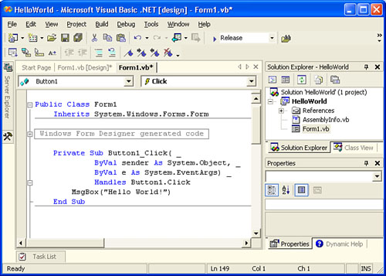
Event-Driven Architecture

Slide 16
Event-Driven Architecture
Event-driven architecture (EDA) is a design paradigm in which a software component executes in response to receiving one or more event notifications.
EDA is more loosely coupled than client/server paradigm because the component that sends the notification doesn’t know the identity of the receiving components at the time of compiling
- Garner -

Slide 17
Event-Driven Architecture
Event-driven architecture (EDA) is a design paradigm in which a software component executes in response to receiving one or more event notifications.
EDA is more loosely coupled than client/server paradigm because the component that sends the notification doesn’t know the identity of the receiving components at the time of compiling
- Garner -

Slide 18
Event-Driven Architecture
Event Consumer
Event Producer
Event Ingestion
Event Consumer
Event Consumer
Notes:
An event-driven architecture consists of event producers that generate a stream of events, and event consumers that listen for the events.
Events are delivered in near real time, so consumers can respond immediately to events as they occur.
Producers are decoupled from consumers – a producer does not know which consumers are listening.
Consumers are also decoupled from each other, and every consumers sees all of the events.

Slide 19
Process Flow
Microservices
UI
API Gateway
Order Processing
Payment Processing
Inventory Management
Notification
Fulfillment
Place Order
Place Order
Charge Credit Card
Return Conf #
Update Inventory
Return Confirmation
Send Order Confirmation
Return Confirmation
Create
Shipping Label
Return Confirmation
Return Confirmation
Return Confirmation

Slide 20
Process Flow
Event Ingester
Event-Driven Architecture
UI
Notify Subscribers
Place Order
Inventory Management
Update Inventory
API Gateway
Place Order
Notifications
Publish Payment Event
Order Processing
Send Order Confirmation
Charge Credit Card
Fulfilment
Payment Processing
Create Shipping Label

Slide 21
Not Queue Based Processing
Event-Driven Architecture
Update Inventory Queue
UI
Order Processing
Place Order
Send Message to Queue
Update Inventory
Send Message to Queue
API Gateway
Order Confirm Queue
Place Order
Notifications
Order Processing
Send Order Confirmation
Send Message to Queue
Fulfilment Queue
Charge Credit Card
Payment Processing
Notifications
Create Shipping Label

Slide 22
Event Consumption Models
Event-Driven Architecture
Event Streaming
Event Consumer
Pub/Sub
Event Producer
Event Ingestion
Event Consumer
Event Consumer
Notes:
There are two primary event consumption models within event-driven architectures:
Pub/Sub – The messaging infrastructure keeps track of subscriptions. When an event is published, it sends the event to each subscriber. After an event is received, it cannot be replayed, and new subscribers do not see the event.
Event Streaming – Events are written to a log. Events are strictly ordered (within a partition) and durable. Clients do not subscribe to the stream, instead a client can read from any part of the stream. The client is responsible for advancing its position in the stream. That means a client can join at any time, and can replay events.

Slide 23
Consumer Processing Variations
Event-Driven Architecture
Simple Event Processing
Event Consumer
Event Producer
Event Ingestion
Complex Event Processing
Event Consumer
Event Consumer
Event Stream Processing
Notes:
Three primary consumer processing variations
Simple event processing – An event immediately triggers an action in the consumer. For example, you could use Azure Functions with a Service Bus trigger, so that a function executes whenever a message is published to a Service Bus topic.
Complex event processing – A consumer processes a series of events, looking for patterns in the event data, using a technology such as Azure Event Stream Analytics or Apache Storm. For example, you could aggregate readings from an embedded device over a time window, and generate a notification if the moving average crosses a certain threshold.
Event stream processing – Use a data streaming platform, such as Azure IoT Hub or Apache Kafka, as a pipeline to ingest events and feed them to stream processors. The stream processors act to process or transform the stream. There may be multiple stream processors for different subsystems on the application. This approach is a good fit for IoT workloads.

Slide 24
External Event Sources
Event-Driven Architecture
Event Consumer
Event Producer
Event Ingestion
Event Consumer
Event Consumer
Notes:
The source of the events may be external to the system, such as physical devices in an IoT solution. In that case, the system must be able to ingest the data at the volume and throughput that is required by the data source.

Slide 25
Multiple Consumer Instances
Event-Driven Architecture
Event Consumer
Event Consumer
Event Consumer
Event Consumer
Event Producer
Event Ingestion
Event Consumer
Event Consumer
Event Consumer
Event Consumer
Event Consumer
Event Consumer
Event Consumer
Event Consumer
Notes:
In the logical diagram here, each consumer is shown as a single box. In practice, it is common to have multiple instances of a consumer, to avoid having the consumer become a single point of failure in a system. Multiple instances might also be necessary to handle the volume and frequency of events.

Slide 26
When to use this architecture
Event-Driven Architecture
Multiple Subsystems
Real-Time Processing
Complex Event Processing
High Volume/Velocity Data
Notes:
Multiple Subsystems
Multiple subsystems must process the same events.
Real-Time Processing
Real-time processing with minimum time lag.
Complex Event Processing
Complex events processing, such as pattern matching or aggregation over time windows.
High Volume/Velocity Data
High volume and high velocity of data, such as IoT.

Slide 27
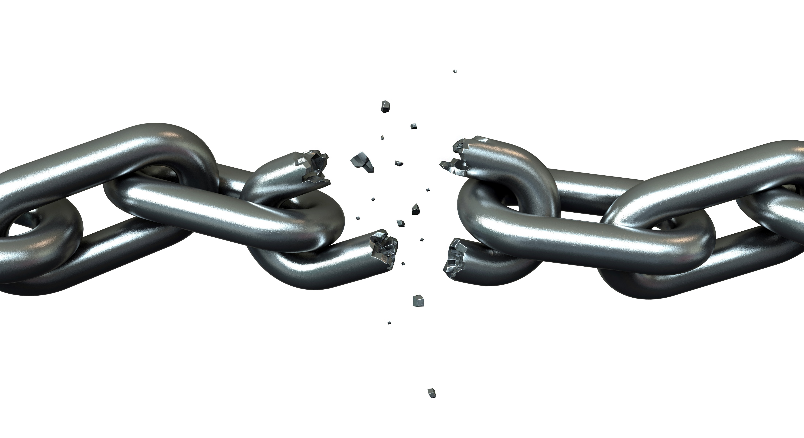

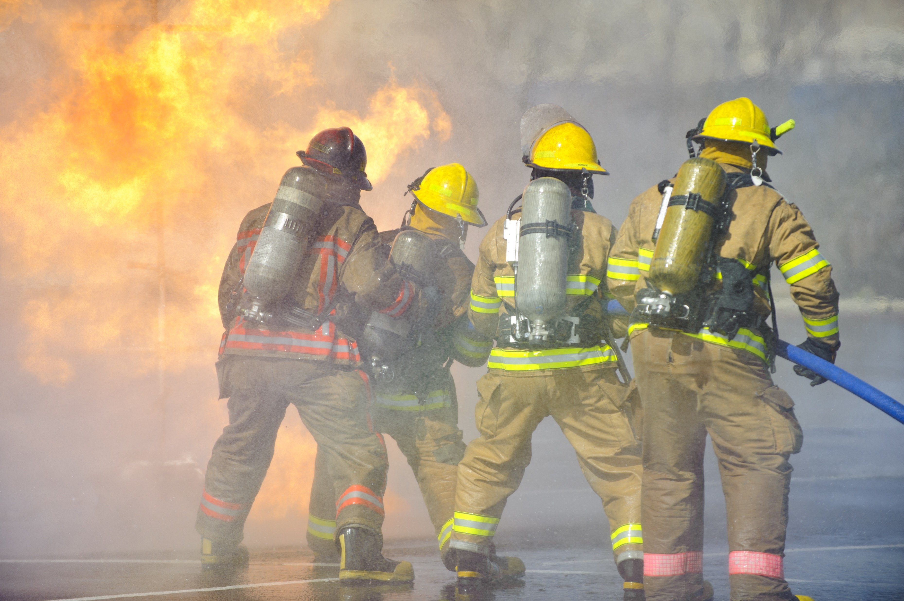
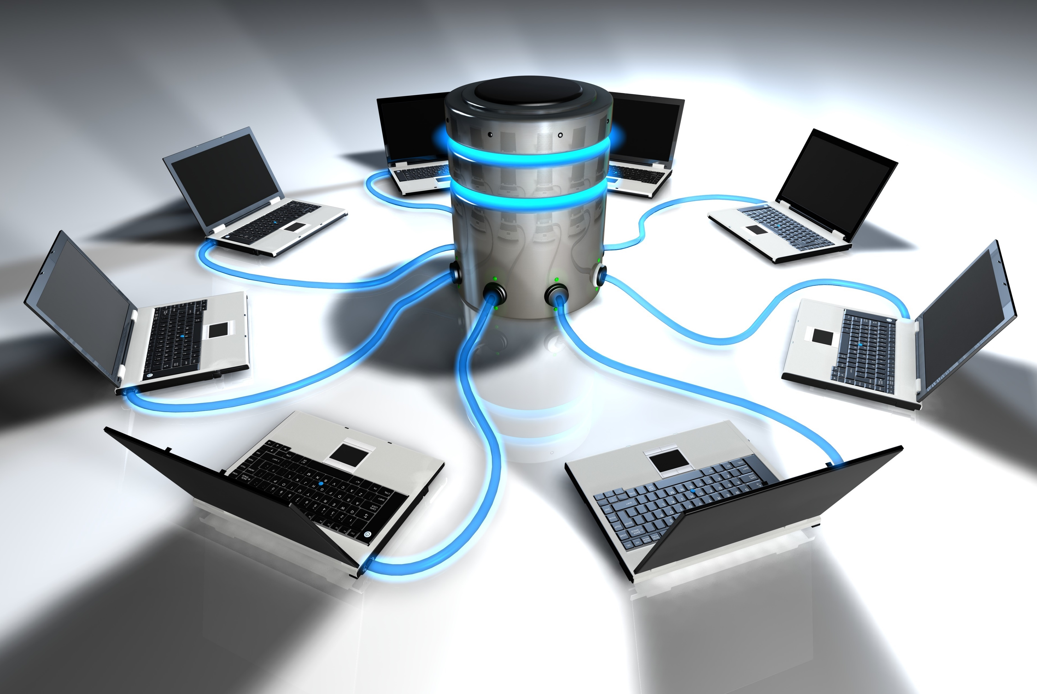

Benefits
Event-Driven Architecture
Decoupling
Encapsulation
Responsive
Scalable/Distributed
Independence
Notes:
Decoupling
Producers and consumers are decoupled
Encapsulation
No point-to-point integrations; easy to add new consumers to the system
Responsive
Consumers can respond to events immediate as they arrive
Scalable/Distributed
Highly scalable and distributed
Independence
Subsystems have independent views of the event stream

Slide 28

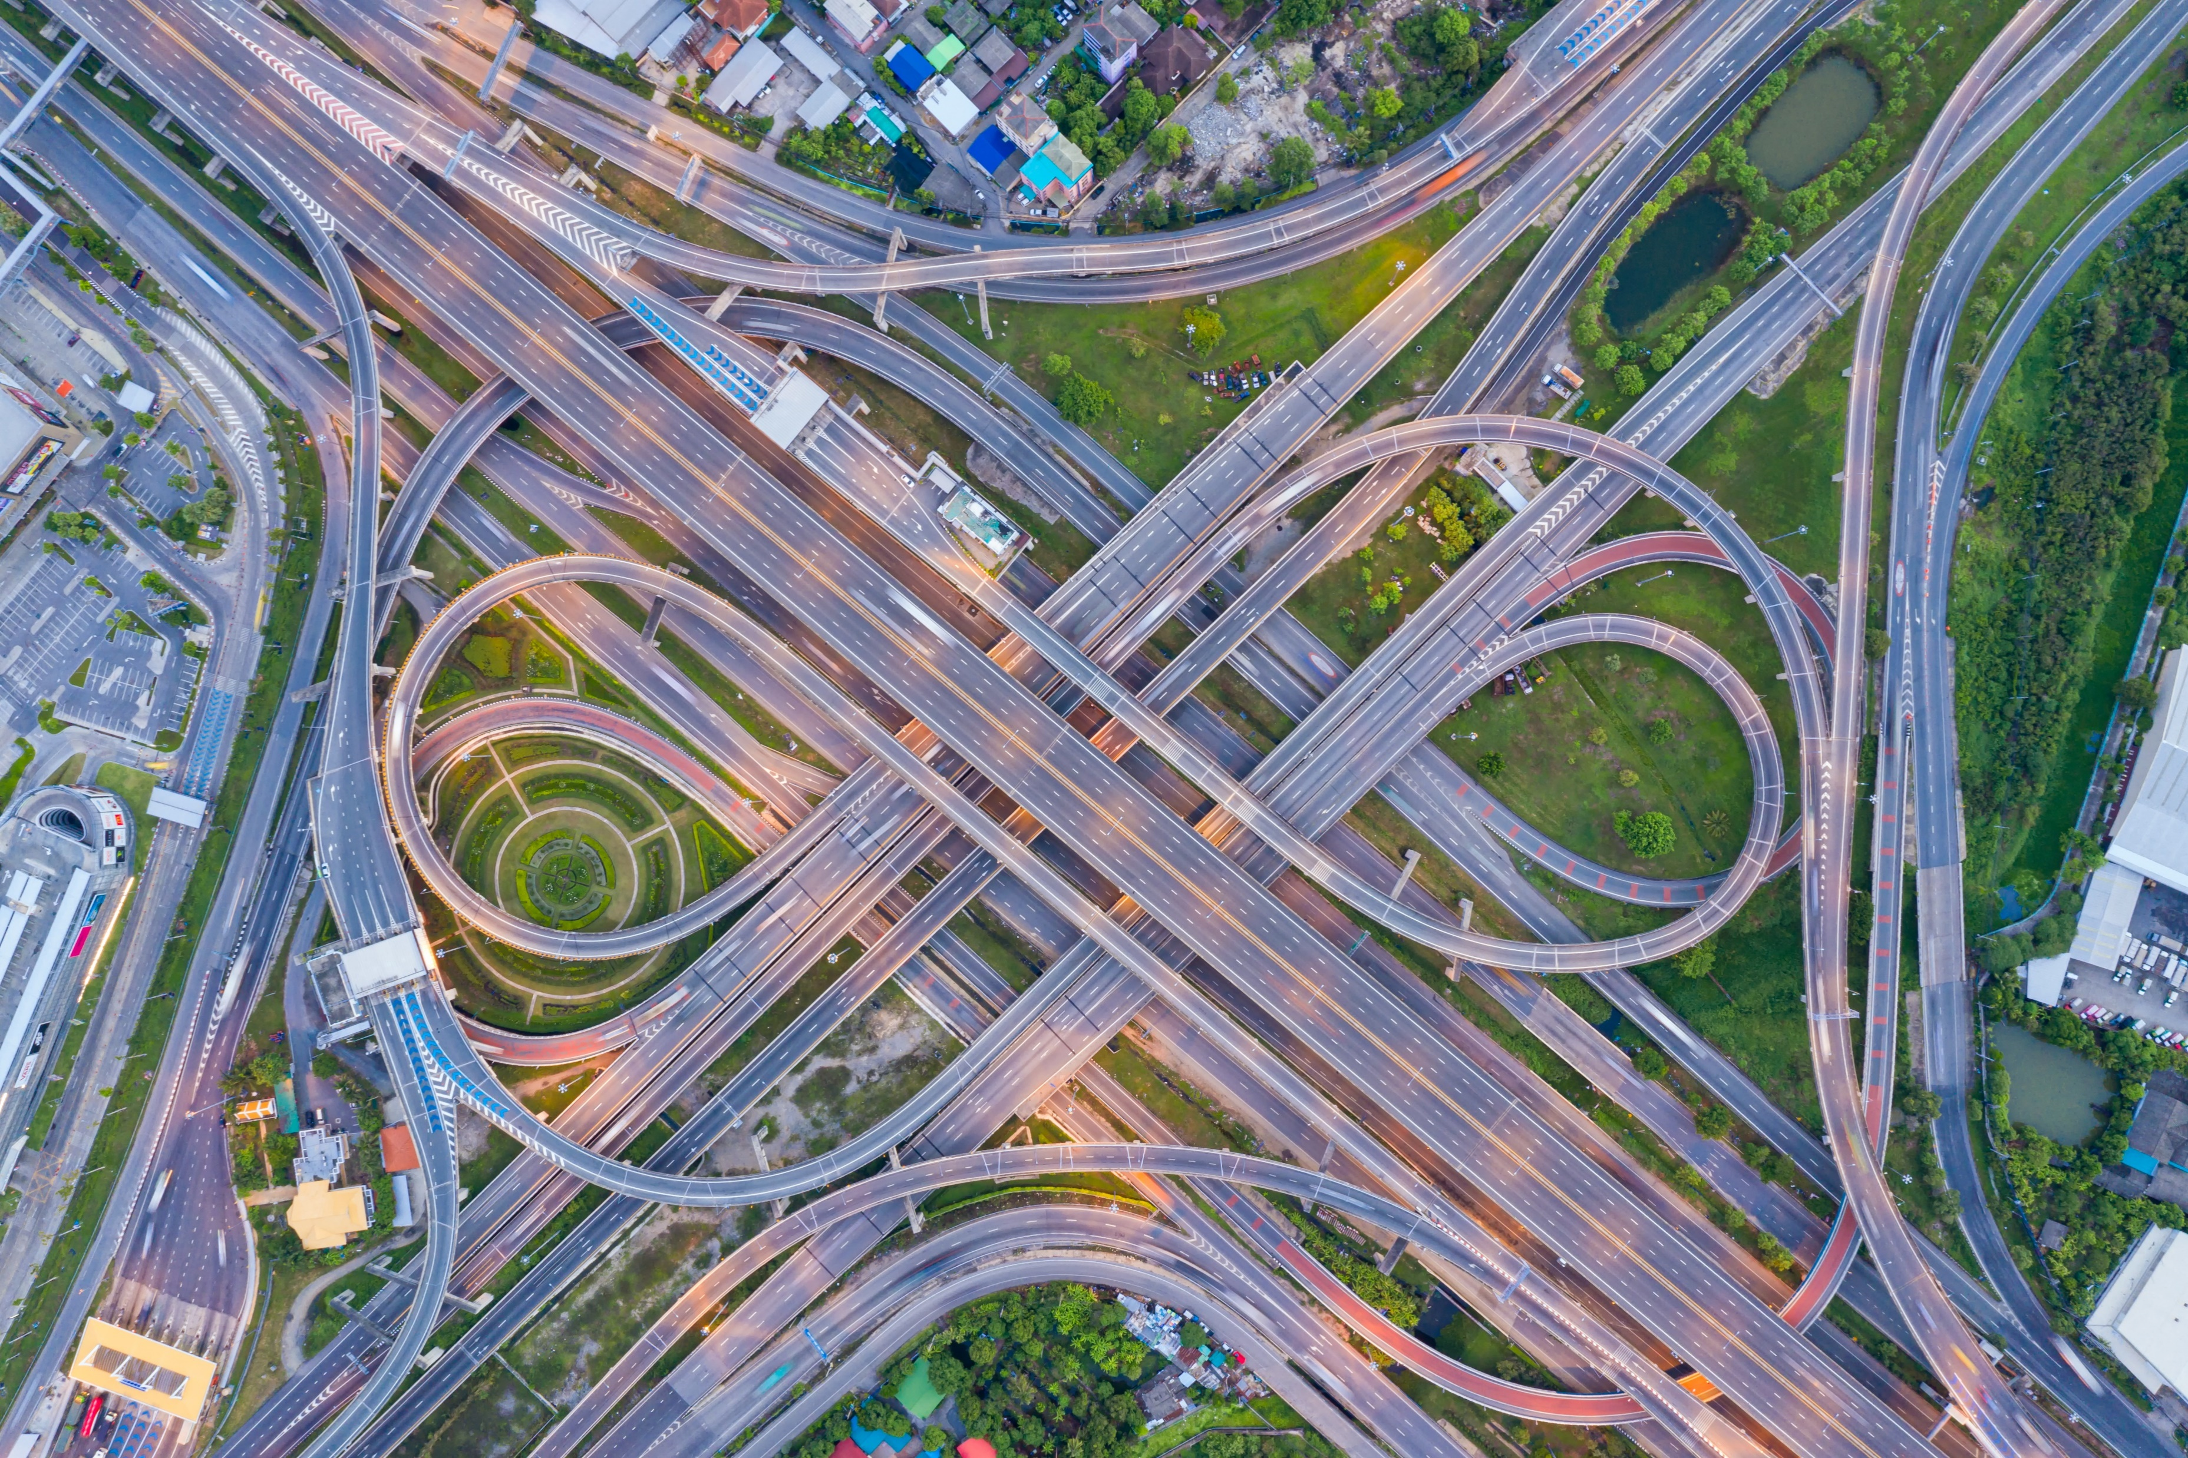


Drawbacks
Event-Driven Architecture
Steep Learning Curve
Complexity
Loss of Transactionality
Lineage

Slide 29

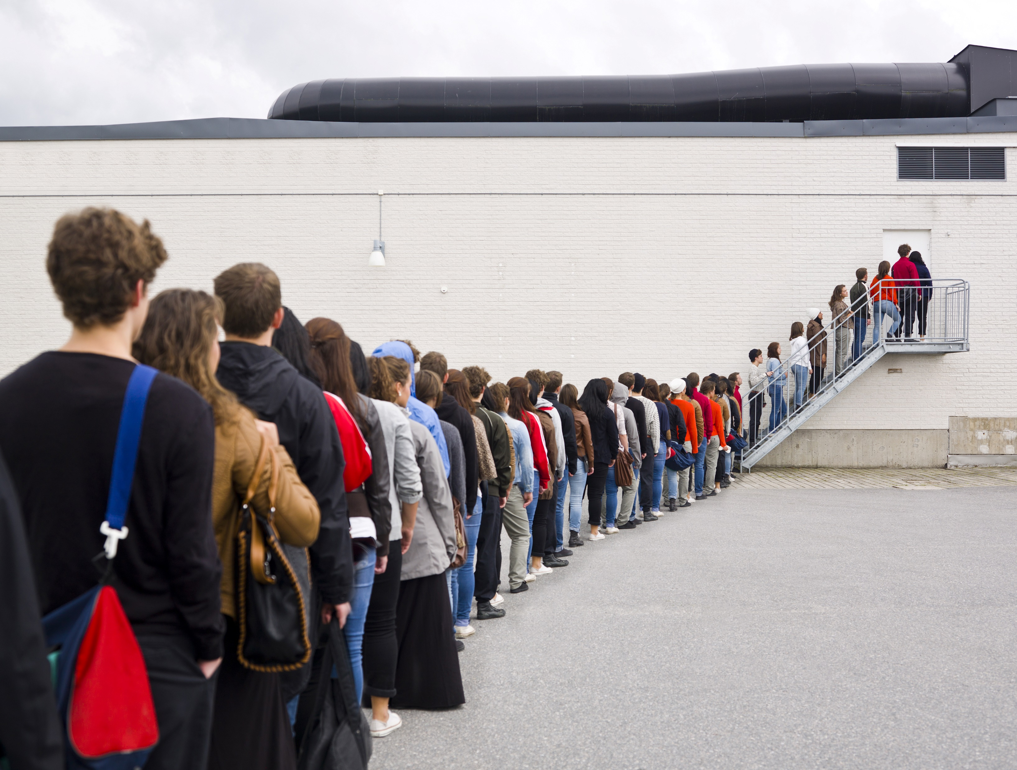
Limitations
Event-Driven Architecture
Guaranteed Delivery
Sequencing
Notes:
Guaranteed Delivery
Guaranteed delivery. In some systems, especially in IoT scenarios, it is crucial to guarantee that events are delivered.
Sequencing
Processing events in order or exactly once. Each consumer type typically ruins in multiple instances, for resiliency and scalability. This can create a challenge if the events must be processed in order (within a consumer type), or if the processing logic is not idempotent.

Slide 30
Implementation Options
Building Event-Driven Microservices

Slide 31

















Implementation Options

Slide 32
Implementation Options

Slide 33
Azure Event Hubs
Simple, secure, and scalable real-time data ingestion
Fully managed, real-time data ingestion service that is simple, trusted, and scalable
Notes:
Event Hubs is a fully managed, real-time data ingestion service that is simple, trusted, and scalable. Steam millions of events per second from any source to build dynamic data pipelines and immediately respond to business challenges. Keep processing data during emergencies using the geo-disaster recovery and geo-replication features.
Integrate seamlessly with other Azure services to unlock valuable insights. Allow existing Apache Kafka clients and applications to talk to Event Hubs without any code changes – you get a managed Kafka experience without having to manage your own clusters. Experience real-time data ingestion and micro-batching on the same stream

Slide 34




Why choose Event Hubs?
Azure Event Hubs
Simple
Secure
Scalable
Open
Notes:
Simple – Build real-time data pipelines with just a couple clicks. Seamlessly integrate with Azure data services to uncover insights faster.
Secure – Protect your real-time data. Event Hubs is certified by CSA, STAR, ISO, SOC, GxP, HIPPA, HITRUST, and PCI.
Scalable – Adjust throughput dynamically based on your usage needs and pay only for what you use.
Open – Ingest data from anywhere and develop across platforms with support for popular protocols, including AMQP, HTTPS, and Apache Kafka.

Slide 35

Key Architecture Components
Azure Event Hubs
Event Producers
Notes:
Event Producers – Any entity that sends data to an even hub. Event publishers can publish events using HTTPS or AMQP 1.0 or Apache Kafka (1.0 and above).

Slide 36
Key Architecture Components
Azure Event Hubs
Partitions
Notes:
Partitions – Each consumer only reads a specific subset, or partition, of the message stream.
Event Hubs provides message streaming through a partitioned consumer pattern in which each consumer only reads a specific subset, or partition, or the message stream. This pattern enables horizontal scale for event processing and provides other stream-focused features that are unavailable in queues and topics.
A partition is an ordered sequence of events that is held in an event hub. As newer events arrive, they are added to the end of this sequence. A partition can be thought of as a “commit log.
Event Hubs retain data for a configured retention time that applies across all partitions in the event hub. Events expire on a time basis; you cannot explicitly delete them. <CLICK> Because partitions are independent and contain their own sequence of data, they often grow at different rates.
The number of partitions is specified at creation and must be between 2 and 32. The partition count is not changeable, so you should consider long-term scale when setting partition count.
Recommendation is to balance 1:1 throughput units and partitions to achieve optimal scale.

Slide 37
Key Architecture Components
Azure Event Hubs
Consumer Groups
Notes:
Consumer Groups – A view (state, position, or offset) of an entire event hub. Consumer groups enable consuming applications to each have a separate view of the event stream. They read the stream independently at their own pace and with their own offsets.

Slide 38
Key Architecture Components
Azure Event Hubs
Throughput Units
Notes:
Throughput Units – Pre-purchased units of capacity that control the throughput capacity of Event Hubs.
A single throughput unit lets you:
Ingress: Up to 1-Mb per second or 1000 events per second (which ever comes first)
Egress: Up to 2-Mb per second or 4096 events per second
ServerBusyException thrown
The Auto-Inflate feature automatically scales up by increasing the number of throughput units, to meet usage needs. Increasing throughput units prevents throttling scenarios

Slide 39
Key Architecture Components
Azure Event Hubs
Event Receivers
Notes:
Event Receivers – Any entity that reads event data from an event hub. All Event Hubs consumers connect via the AMQP 1.0 session. The Event Hubs service delivers events through a session as they become available. All Kafka consumers connect via the Kafka protocol 1.0 and later.

Slide 40
Demonstration
Building Event-Driven Microservices

Slide 41
Scenario
Event Hub
Demonstration
UI
Notify Subscribers
Place Order
Inventory Management
Update Inventory
API Gateway
Place Order
Notifications
Publish Payment Event
Order Processing
Send Order Confirmation
Charge Credit Card
Fulfilment
Payment Processing
Create Shipping Label

Slide 42


Slide 43
Portfolio Management
Resident Management
Resident Management
Care Management
Lease Management
PM
RM
CM
LM

Slide 44
Resident Move-In
Portfolio Management
Resident Management
Resident Management
Care Management
Lease Management
PM
RM
CM
LM

Slide 45
Resident Move-In
Portfolio Management
Resident Management
Care Management
Lease Management
PM
RM
CM
LM

Slide 46
Resident Move-In
Portfolio Management
Resident Management
Resident Management
Care Management
Lease Management
PM
RM
CM
LM
Event Ingestor
PM Listener
RM Listener
CM Listener
LM Listener

Slide 47
Upgrade Care
Portfolio Management
Resident Management
Resident Management
Care Management
Lease Management
PM
RM
CM
LM
Event Ingestor
PM Listener
RM Listener
CM Listener
LM Listener

Slide 48
Upgrade Care
Portfolio Management
Resident Management
Resident Management
Care Management
Lease Management
PM
RM
CM
LM
Event Ingestor
PM Listener
RM Listener
CM Listener
LM Listener

Slide 49
Upgrade Care
License Management
Portfolio Management
Resident Management
Resident Management
Care Management
Lease Management
LicM
PM
RM
CM
LM
Event Ingestor
LicM Listener
PM Listener
RM Listener
CM Listener
LM Listener

Slide 50
Summary
Building Event-Driven Microservices

Slide 51
Event-Driven Architecture
Summary
Event-driven architecture (EDA) is a design paradigm in which a software component executes in response to receiving one or more event notifications.
EDA is more loosely coupled than client/server paradigm because the component that sends the notification doesn’t know the identity of the receiving components at the time of compiling
- Garner -

Slide 52
SWOT
Summary
Strengths
Decoupling
Encapsulation
Responsive
Scalable / Distributed
Independence
Notes:
Strengths
Decoupling - Producers and consumers are decoupled
Encapsulation - No point-to-point integrations; easy to add new consumers to the system
Responsive - Consumers can respond to events immediate as they arrive
Scalable/Distributed - Highly scalable and distributed
Independence - Subsystems have independent views of the event stream
Opportunities
Multiple Subsystems - Multiple subsyustems must process the same events
Real-Time Processing - Real-=time processing with minimum time lag
Complex Event Processing - Complex event processing, such as pattern matching or aggregation over time windows
High Volumne/Velocity Data - High volume and high velocity of data, such as IoT

Slide 53
SWOT
Summary
Strengths
Weaknesses
Decoupling
Encapsulation
Responsive
Scalable / Distributed
Independence
Steep Learning Curve
Complexity
Loss of Transactionality
Linage

Slide 54
SWOT
Summary
Strengths
Weaknesses
Opportunities
Decoupling
Encapsulation
Responsive
Scalable / Distributed
Independence
Steep Learning Curve
Complexity
Loss of Transactionality
Linage
Multiple Subsystems
Real-Time Processing
Complex Event Processing
High Volume / Velocity Data
Notes:
Opportunities
Multiple Subsystems - Multiple subsystems must process the same events
Real-Time Processing - Real-=time processing with minimum time lag
Complex Event Processing - Complex event processing, such as pattern matching or aggregation over time windows
High Volume/Velocity Data - High volume and high velocity of data, such as IoT

Slide 55
SWOT
Summary
Strengths
Weaknesses
Opportunities
Threats
Decoupling
Encapsulation
Responsive
Scalable / Distributed
Independence
Steep Learning Curve
Complexity
Loss of Transactionality
Linage
Multiple Subsystems
Real-Time Processing
Complex Event Processing
High Volume / Velocity Data
No Guaranteed Delivery
Potential Sequencing Issues

Slide 56
SWOT
Summary
Strengths
Weaknesses
Opportunities
Threats
Decoupling
Encapsulation
Responsive
Scalable / Distributed
Independence
Steep Learning Curve
Complexity
Loss of Transactionality
Linage
Multiple Subsystems
Real-Time Processing
Complex Event Processing
High Volume / Velocity Data
No Guaranteed Delivery
Potential Sequencing Issues

Slide 57
Event-Driven Architecture
Summary
Event Consumer
Event Producer
Event Ingestion
Event Consumer
Event Consumer
Notes:
An event-driven architecture consists of event producers that generate a stream of events, and event consumers that listen for the events.
Events are delivered in near real time, so consumers can respond immediately to events as they occur.
Producers are decoupled from consumers – a producer does not know which consumers are listening.
Consumers are also decoupled from each other, and every consumers sees all of the events.

Slide 58
Azure Event Hubs
Summary
Fully managed, real-time data ingestion service that is simple, trusted, and scalable
Simple
Secure
Scalable
Open
Notes:
Simple – Build real-time data pipelines with just a couple clicks. Seamlessly integrate with Azure data services to uncover insights faster.
Secure – Protect your real-time data. Event Hubs is certified by CSA, STAR, ISO, SOC, GxP, HIPPA, HITRUST, and PCI.
Scalable – Adjust throughput dynamically based on your usage needs and pay only for what you use.
Open – Ingest data from anywhere and develop across platforms with support for popular protocols, including AMQP, HTTPS, and Apache Kafka.

Slide 59
Real-World Demonstrations
Portfolio Management
Resident Management
Resident Management
Care Management
Lease Management
PM
RM
CM
LM
Event Ingestor
PM Listener
RM Listener
CM Listener
LM Listener

Slide 60
Thank You
chadgreen@chadgreen.com
TaleLearnCode
ChadGreen.com
ChadGreen & TaleLearnCode
ChadwickEGreen

